Slide 1
Roundtable: High Score!
Diana Solis - Creative Coding Section A

Slide 2
Idea 1: Horror Story Adventure!
Story driven, adventure, move throughout different scenes!

Slide 3
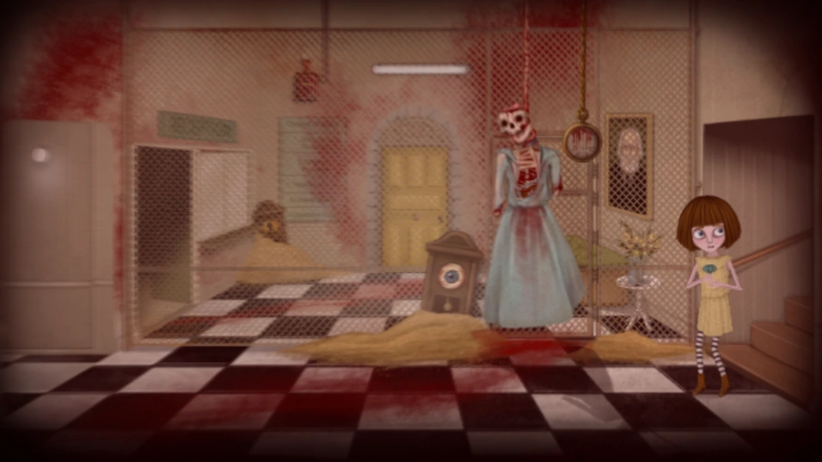
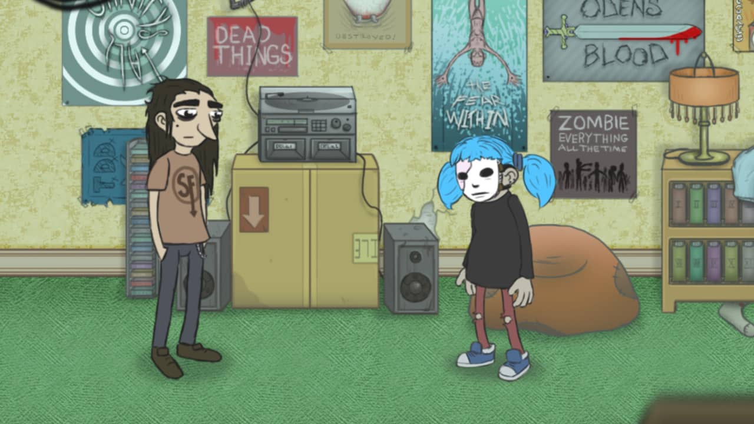
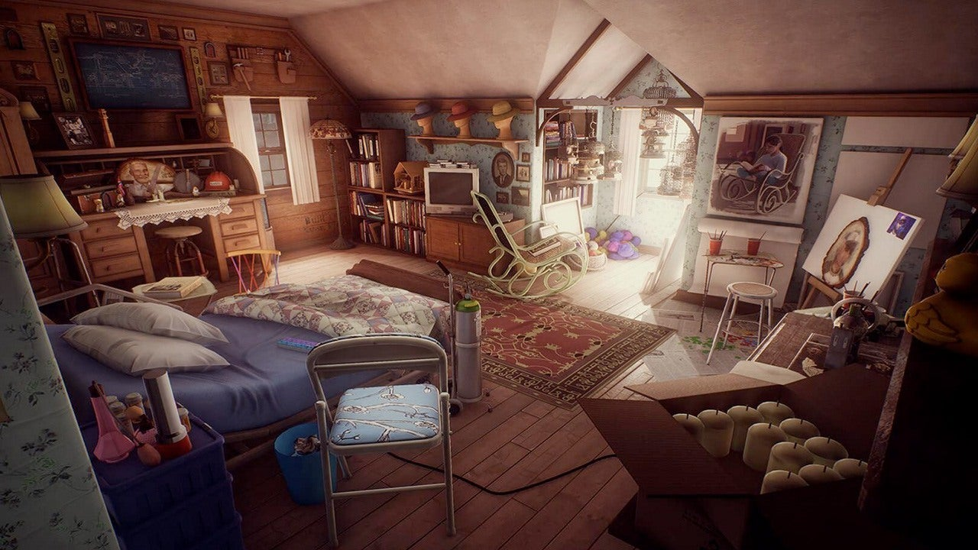
Inspiration
Sally Face, Fran Bow, What Remains of Edith Finch…

Slide 4
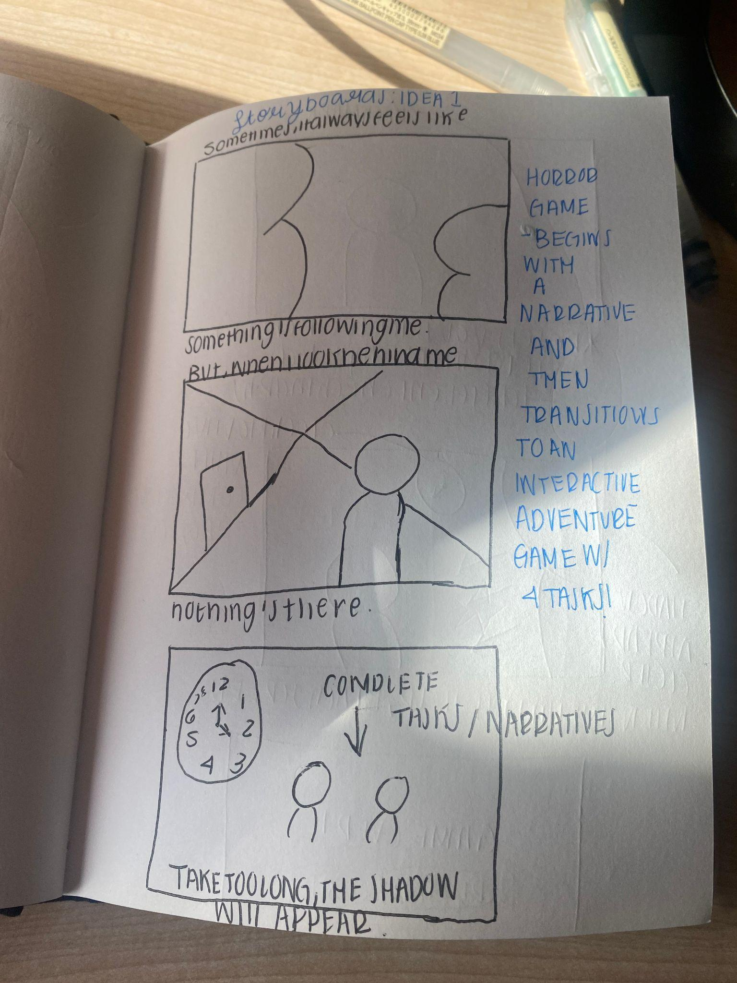
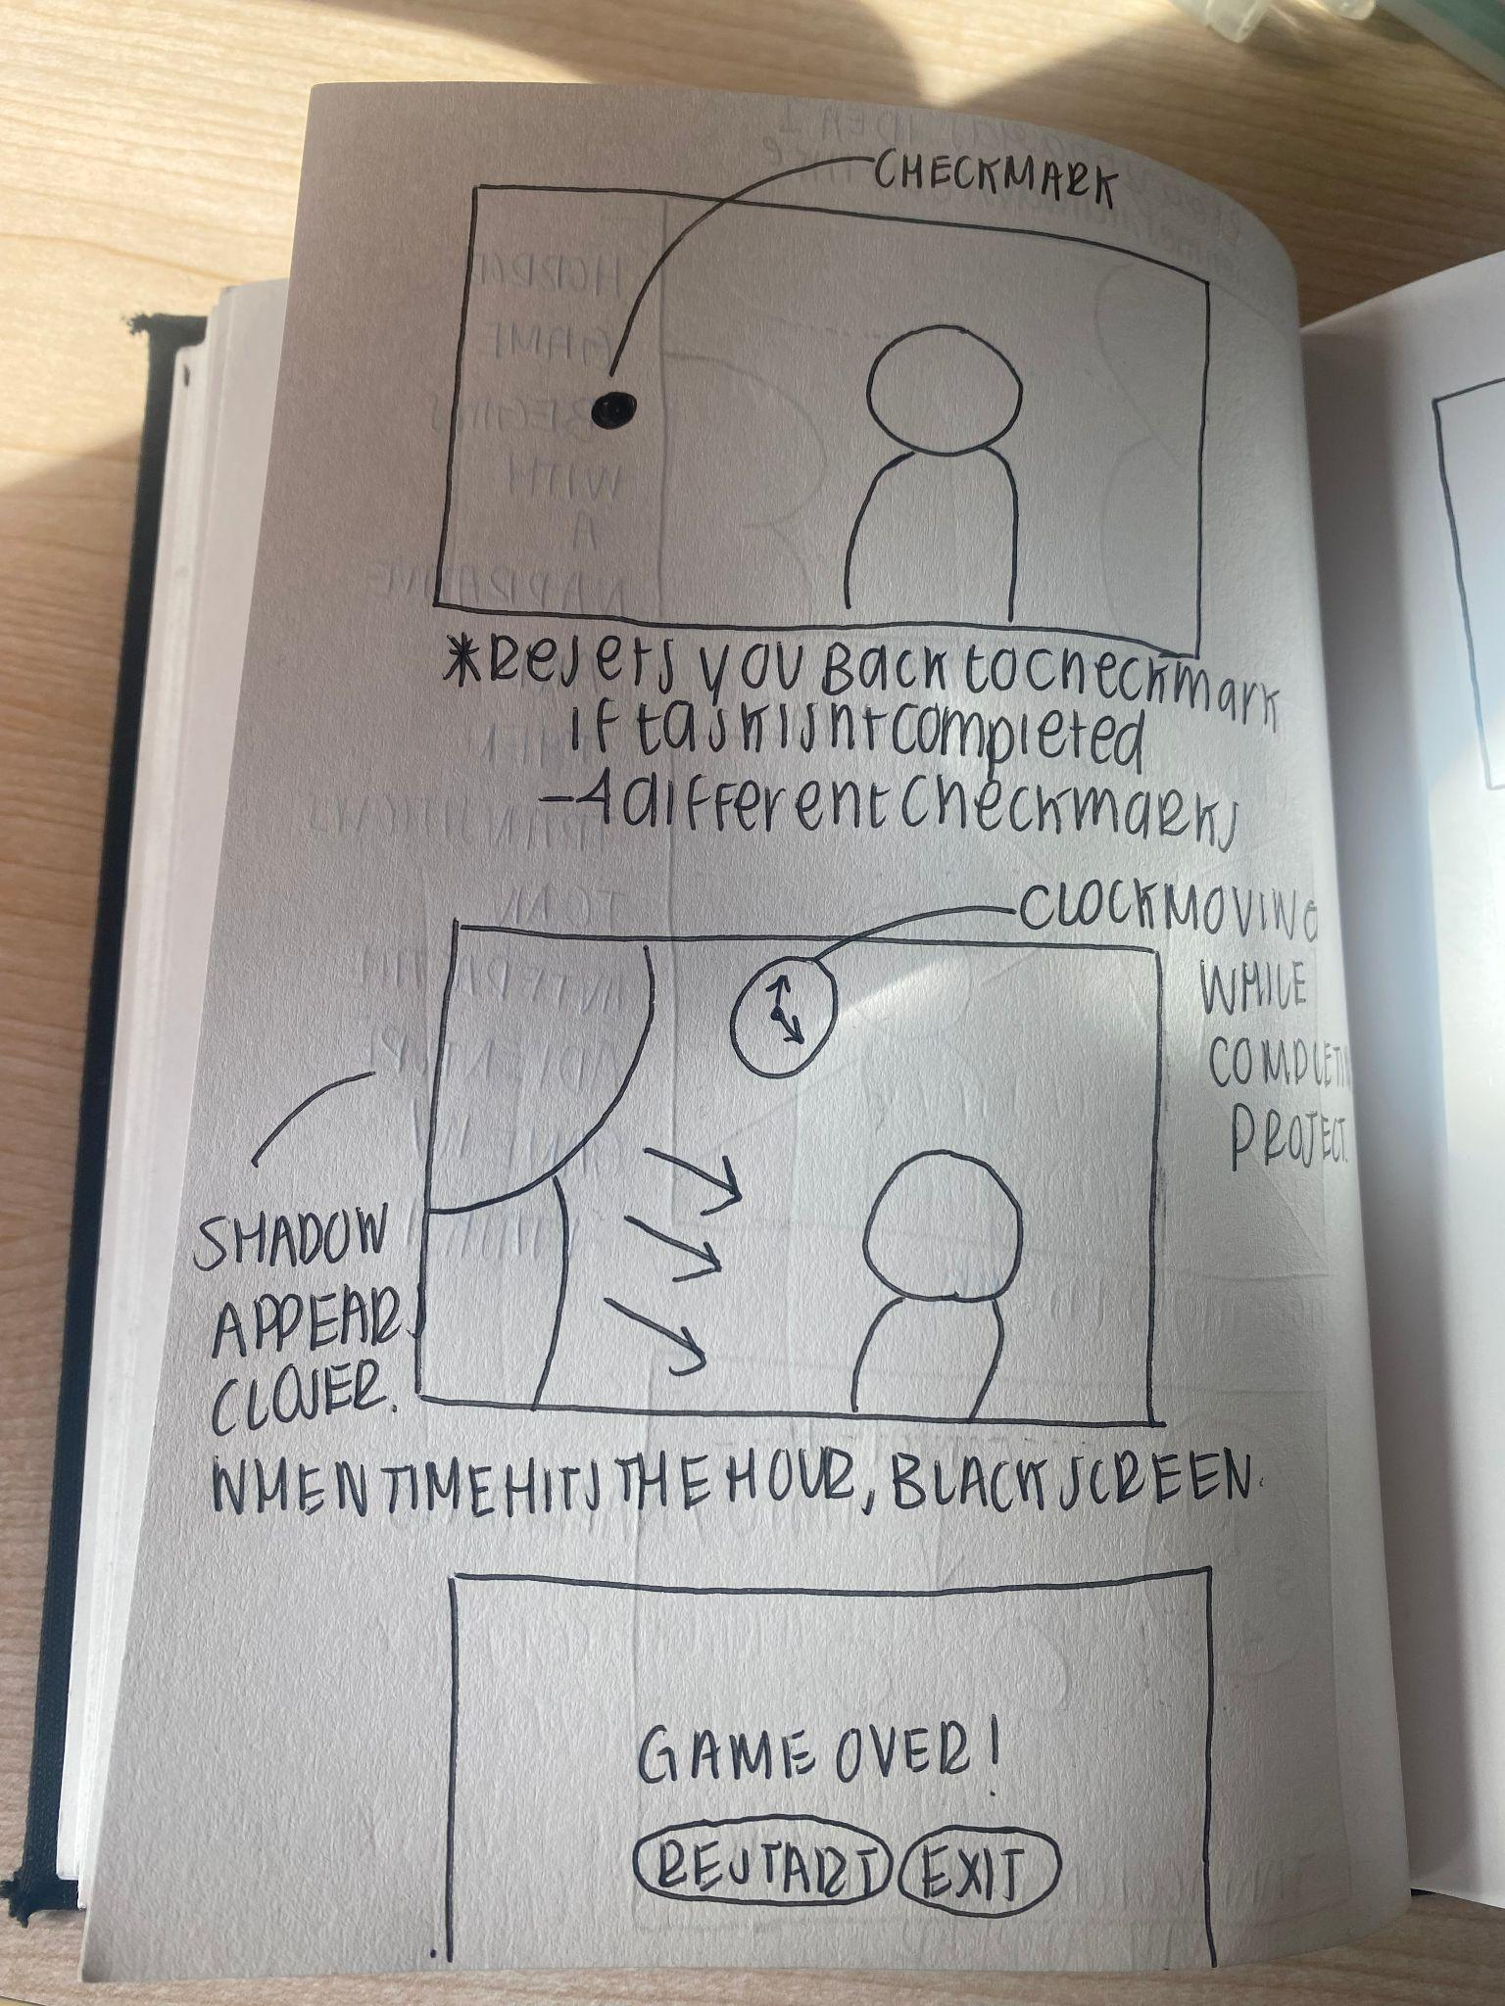
Storyboards

Slide 5
Game Mechanics:
- KeyPressed to move characters
- Using time as a main objective:
- Conditionals occur if a certain time limit is reached and a certain action has not been completed.
- Growth of an object over time - using scale

Slide 6
Idea 2: Puzzle Game
Relaxing, mental zen, slow movements!

Slide 7
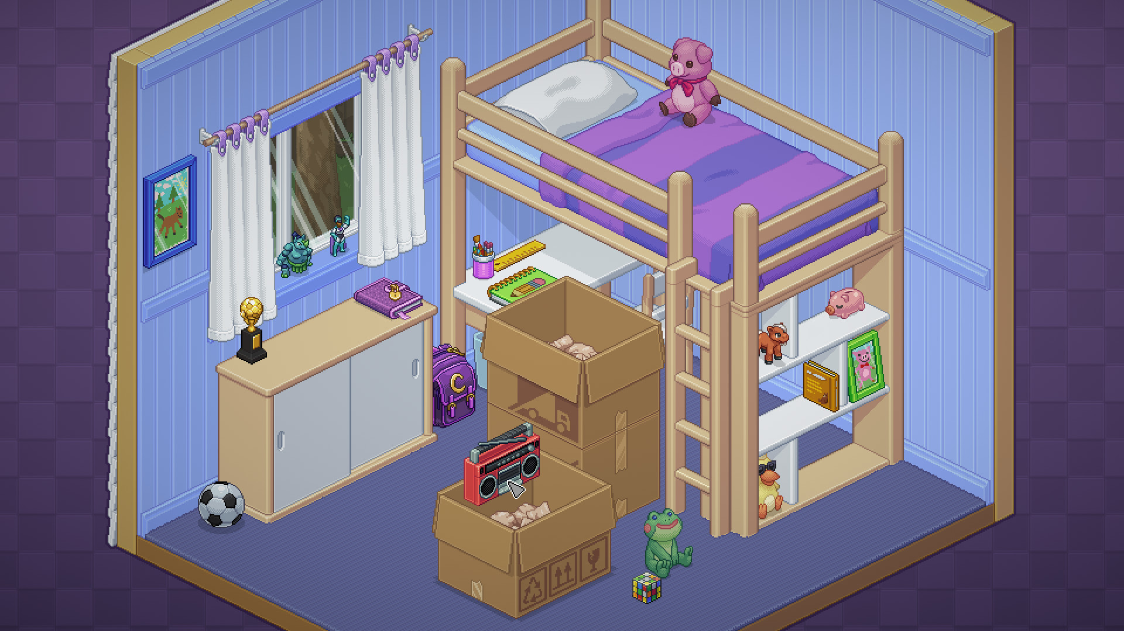
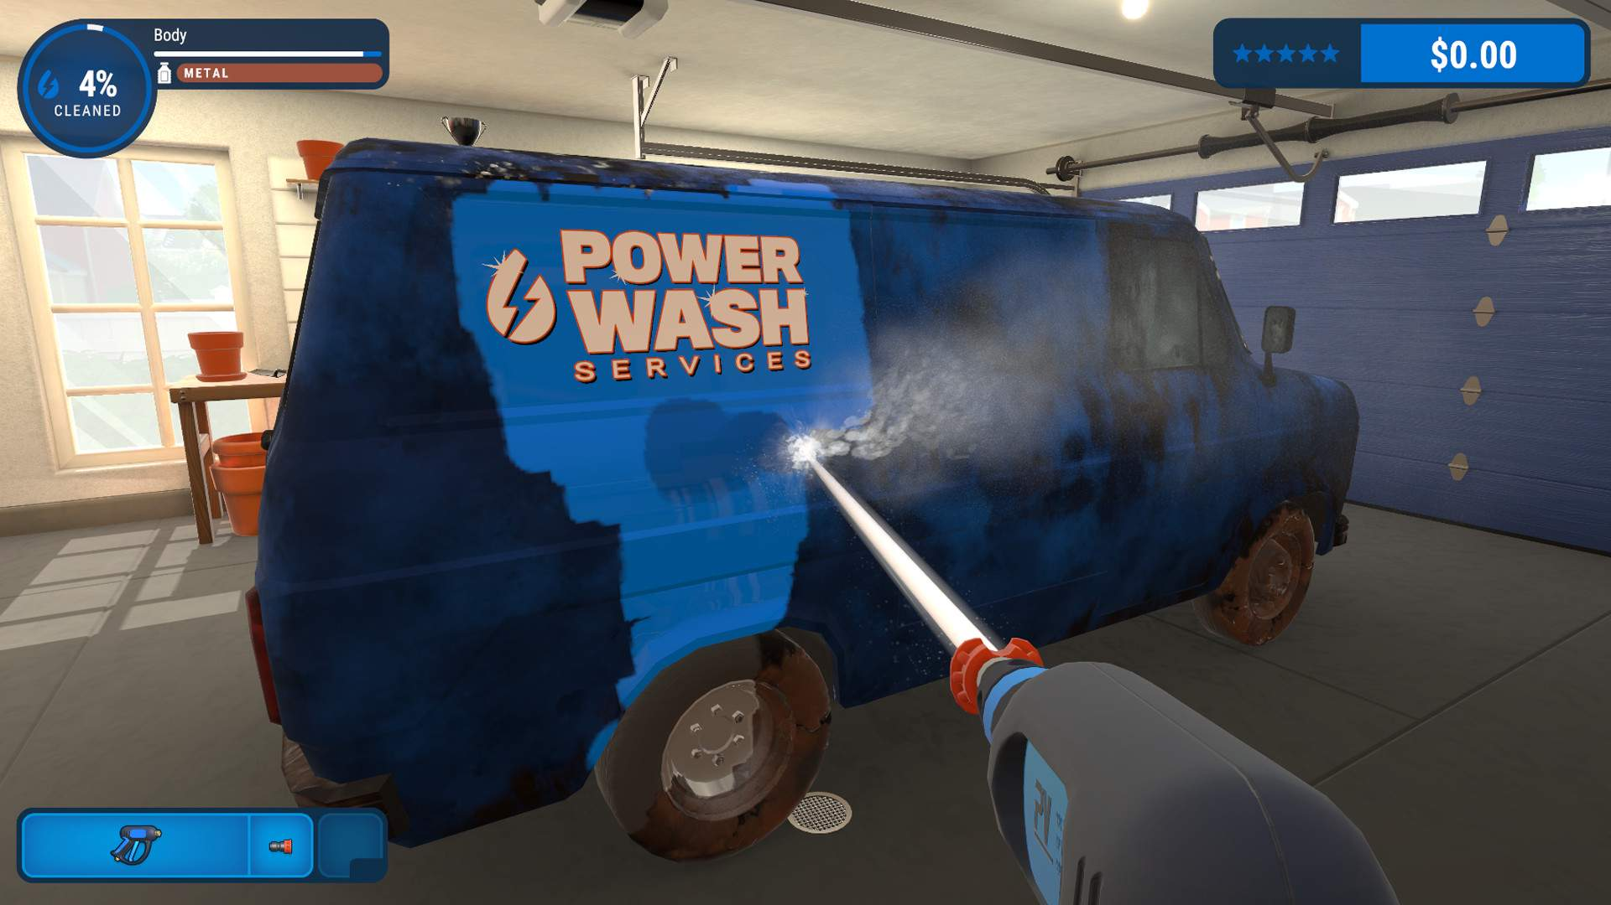
Inspiration
Unpacking, Powerwash Simulator, American Truck Simulator…

Slide 8
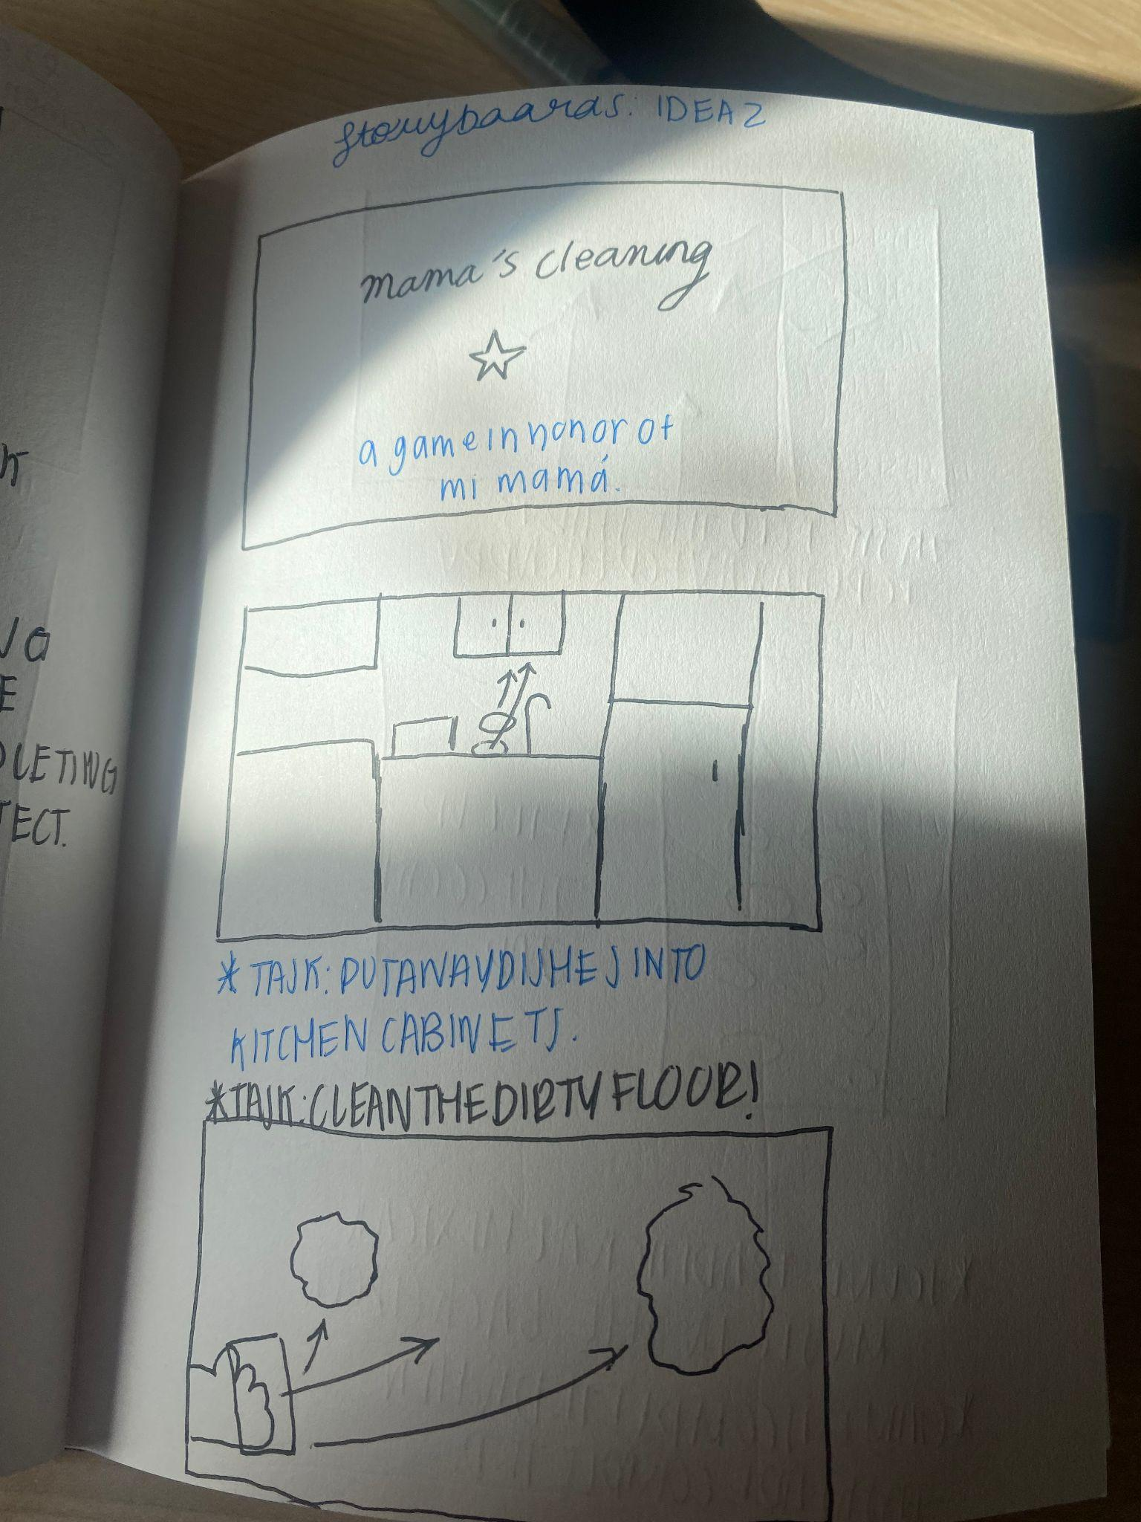
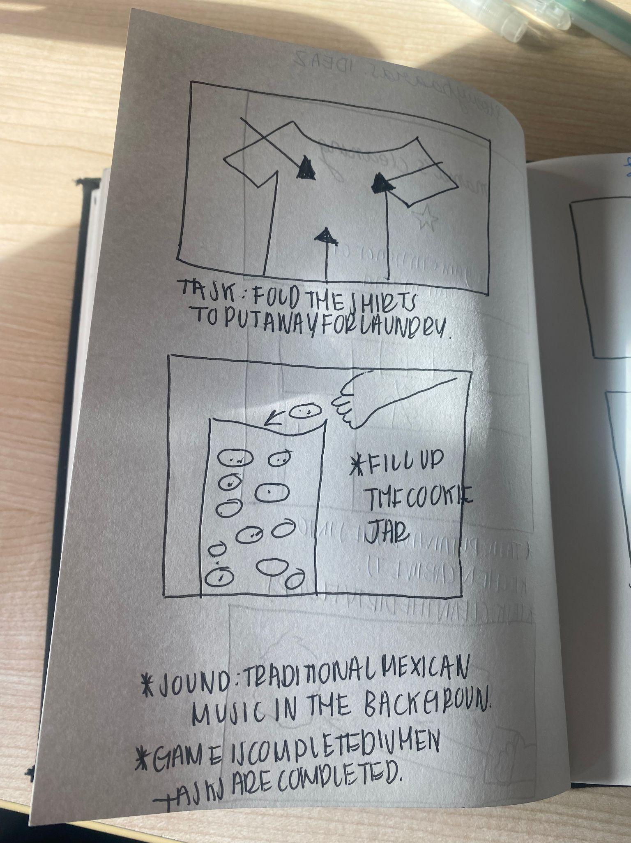
Storyboards

Slide 9
Game Mechanics
Connecting the mouse to the cursor and such:
When the mouse is moved over a certain object, the color will change indicating the state of the floor as such being “cleaned”
Being able to use my mouse to the advantage and be able to demonstrate how it connects to an object and can move it
Object orientated programming - creating different classes for each object!

Slide 10
Idea 3: Time-driven Narrative
If you had the chance to go back in time, would you do it?
Sentimental, emotional, first-person!

Slide 11
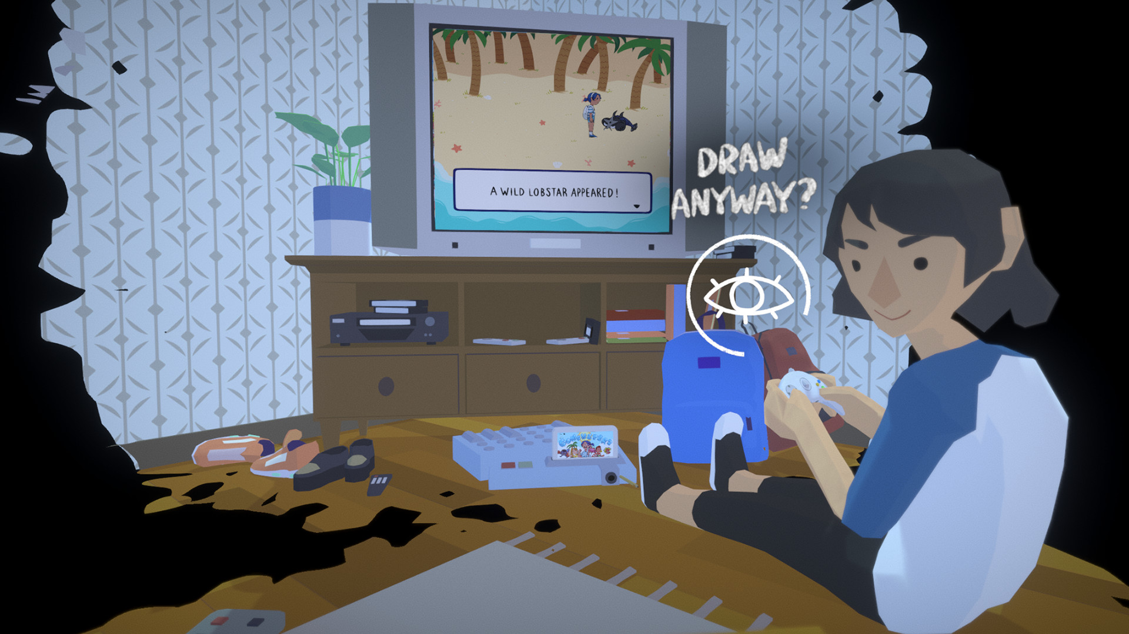
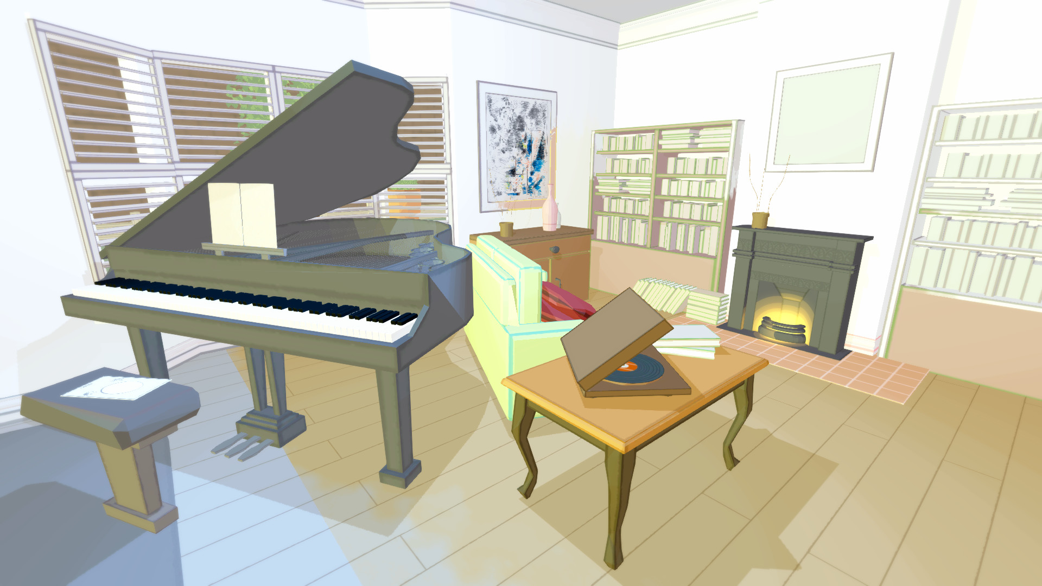
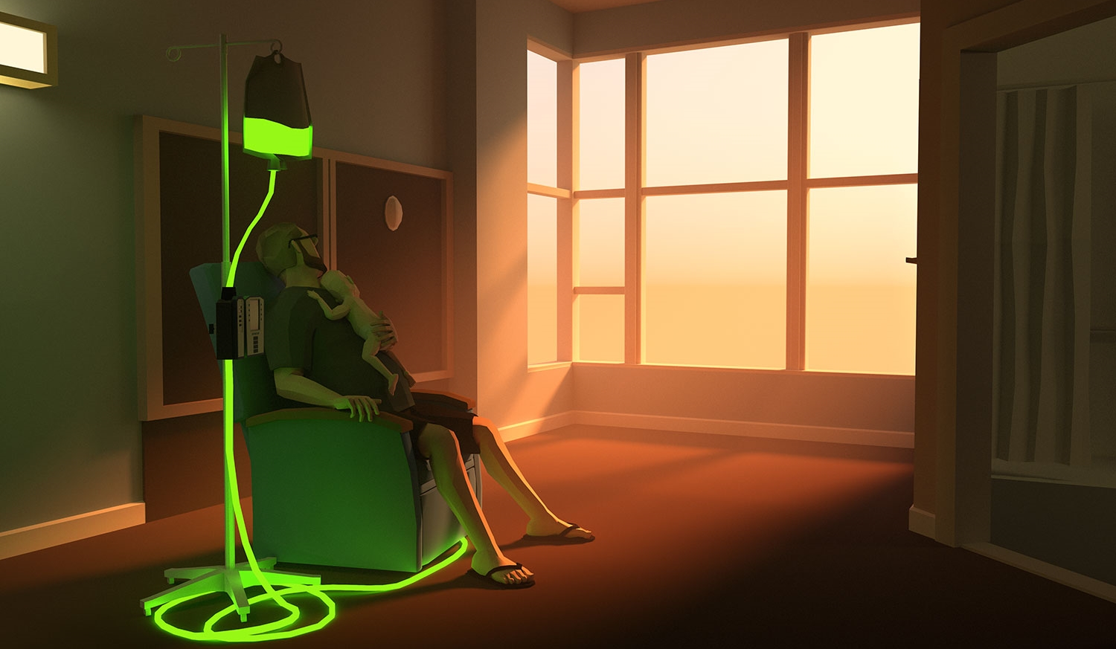
Inspiration
Before Your Eyes, Before I Forget, That Dragon, Cancer…

Slide 12
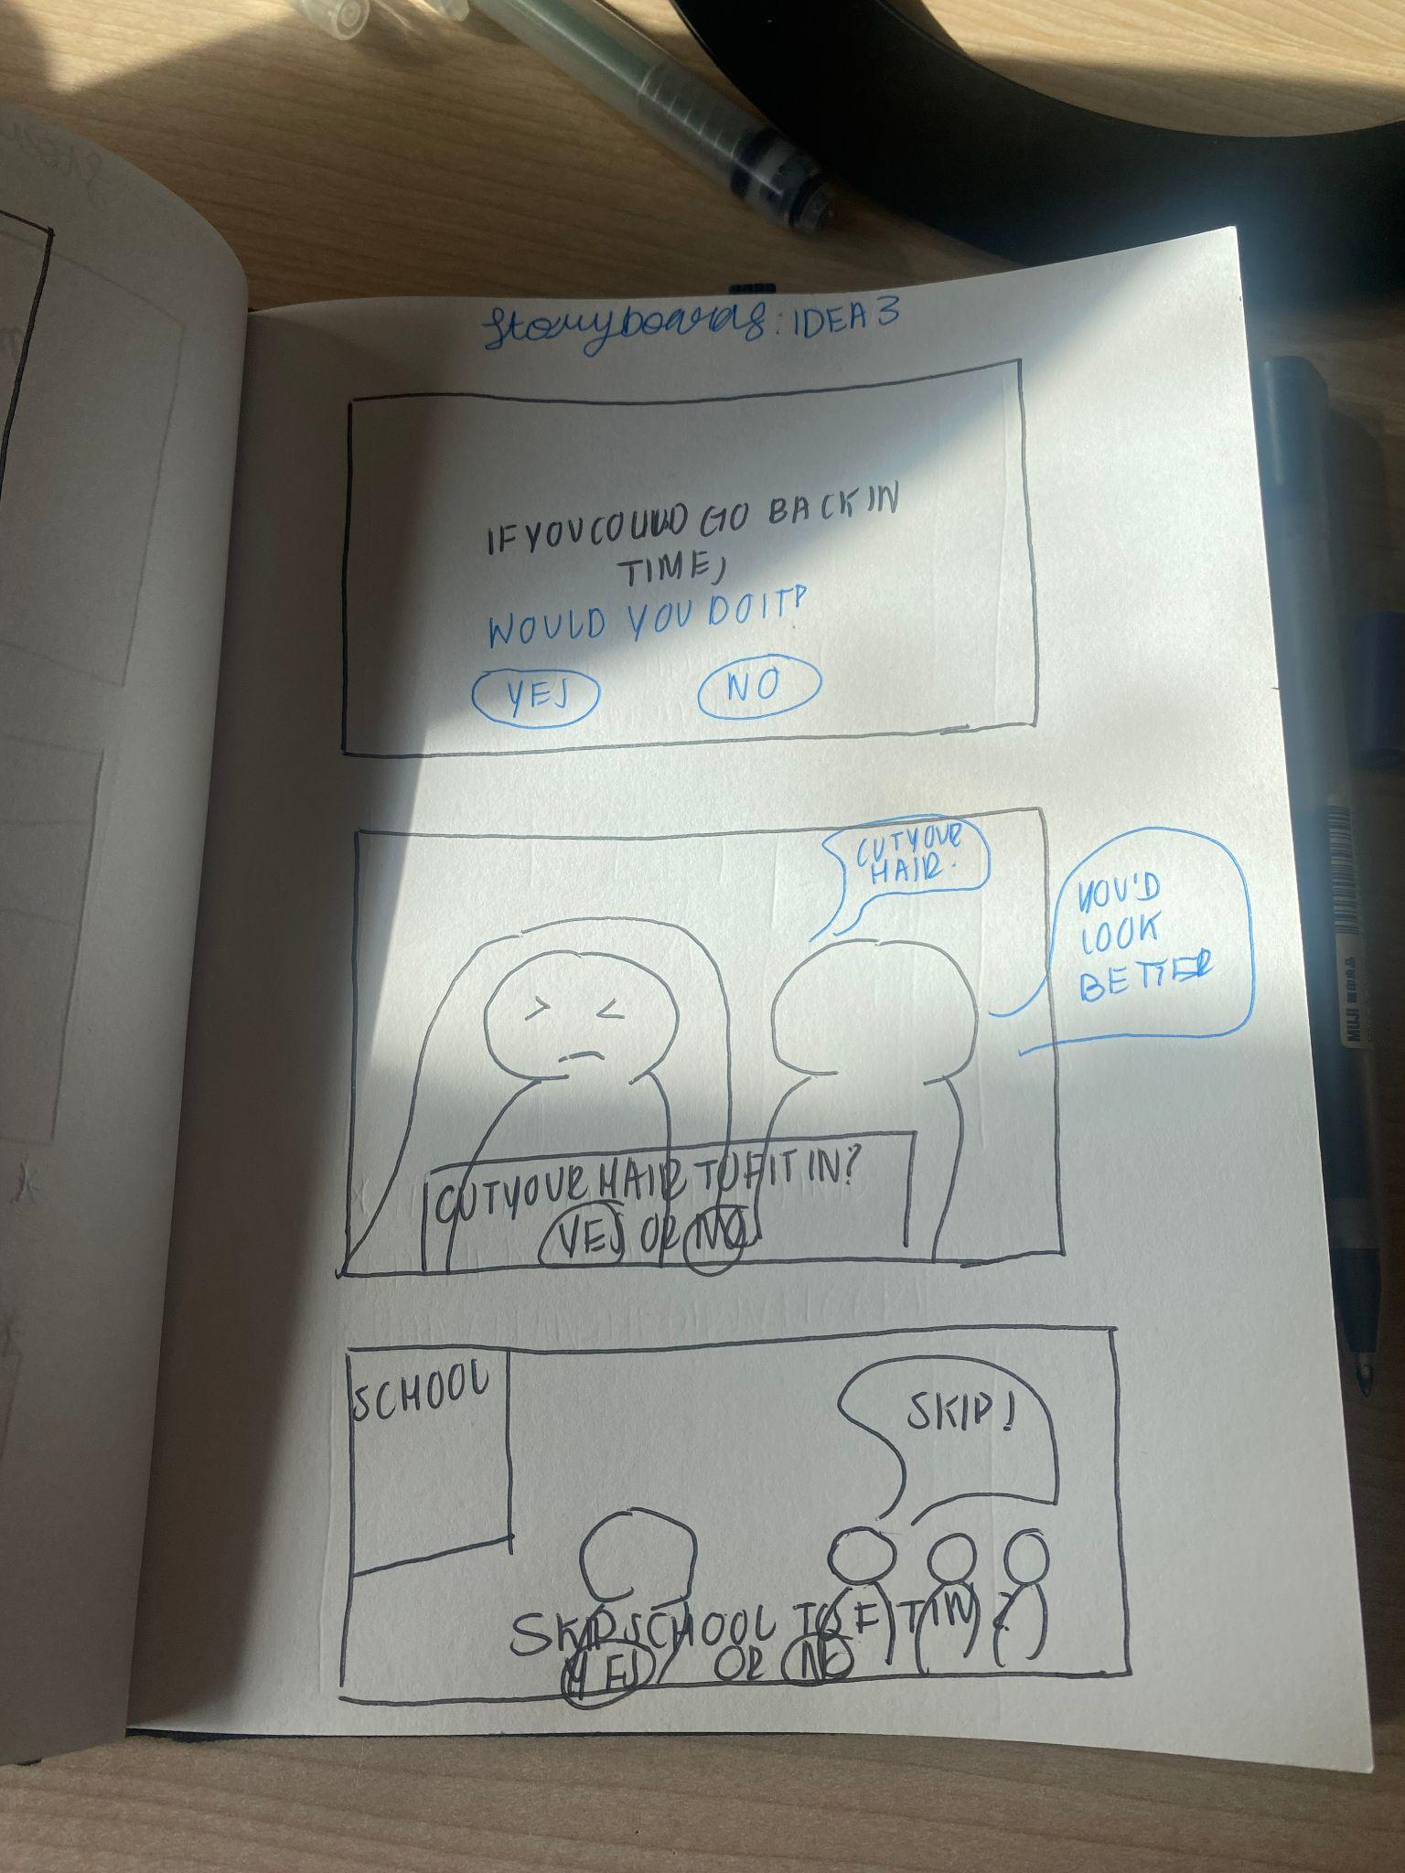
Storyboard

Slide 13
Game Mechanics
Using conditionals is the main format:
If this → This occurs
If this doesn't occur → A different narrative is created
Very narrative based - motion of characters will indicate a story whether it’s emotion based or task completing.
TIME: TIME IS TICKING! If you don’t pick → A randomized narrative will be chosen for you.

